Slide 1




What’s on your phone?
Jonghoon David Lee

Slide 2
Why the Play Store?
z

Slide 3
The Model Essentials
Features (i.e. a set of levers)
Sentiment polarity score
Sentiment subjectivity score
Review counts
App rating
Content Ratings i.e. Everyone, Everyone 10+, Mature, etc
Target
The number of installs

Slide 4
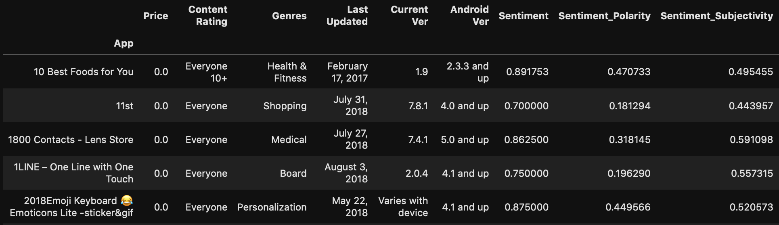
The Google Play Store App Dataset by Lavanya Gupta on Kaggle
z
Notes:
Polynomials on sentiment polarity

Slide 5
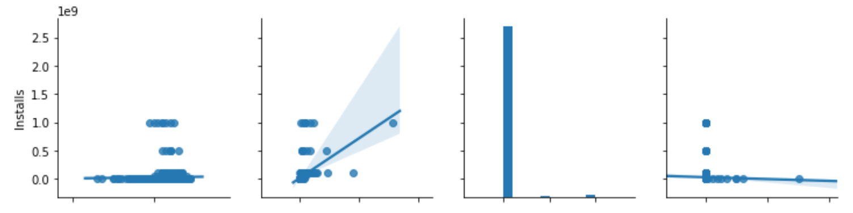
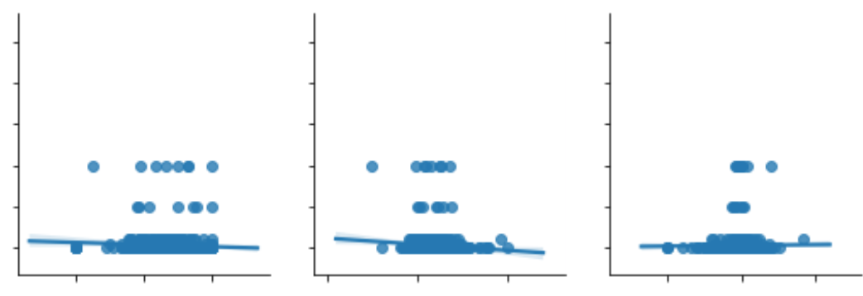
Why the Linear Regression?
z

Slide 6
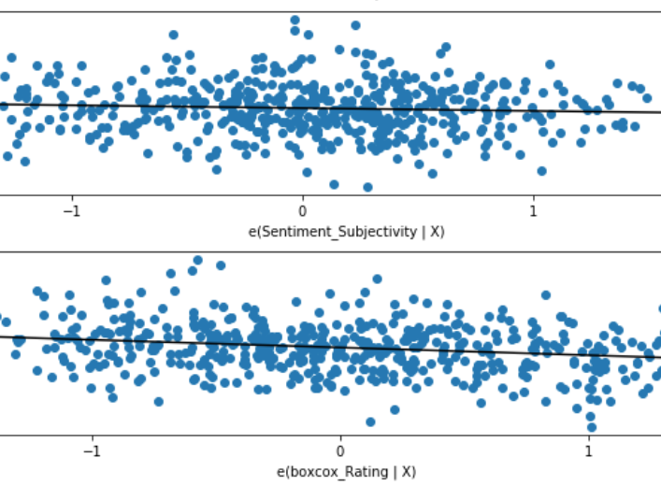
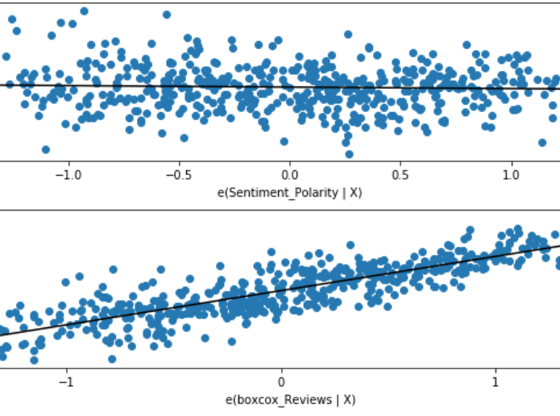
z
Linearity

Slide 7
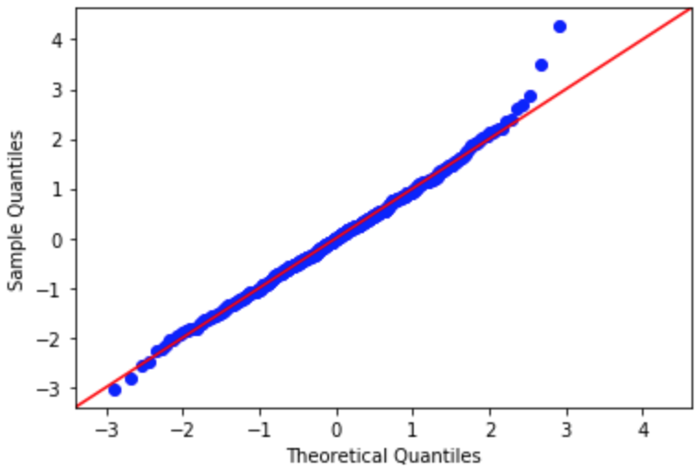
Normality
z

Slide 8
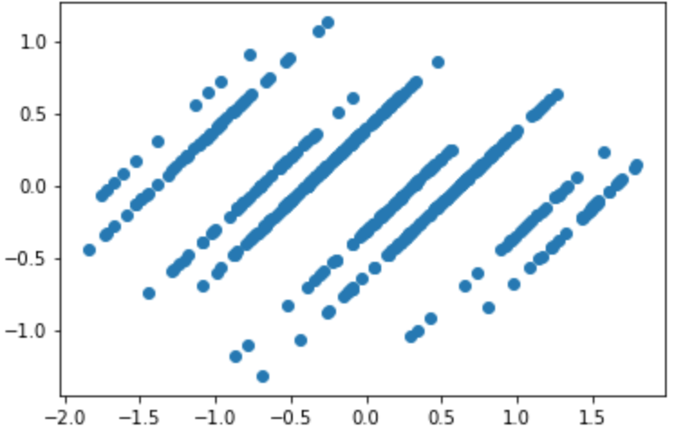
Homoscedasticity
z

Slide 9
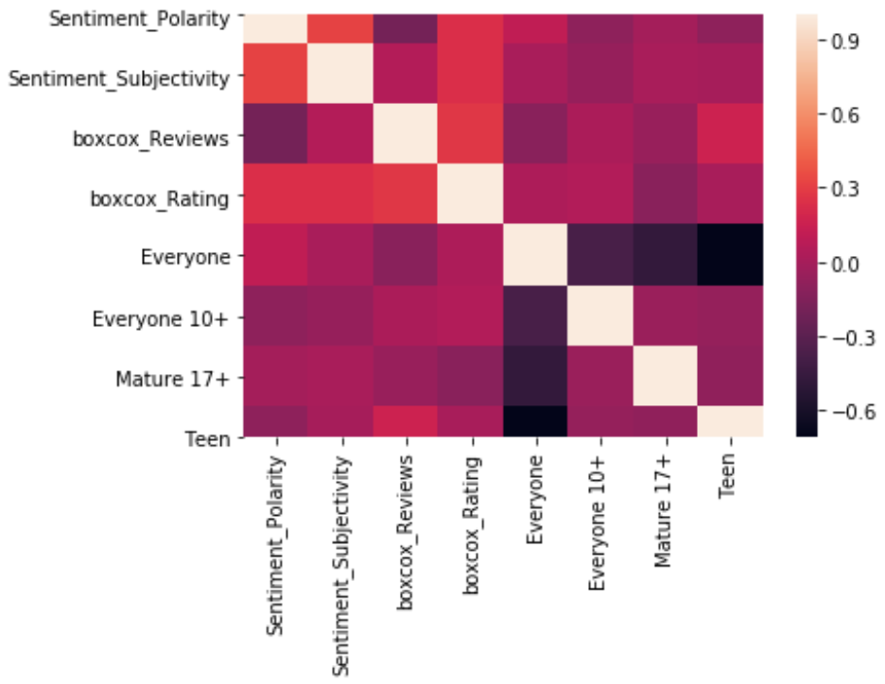
Multicollinearity
z

Slide 10
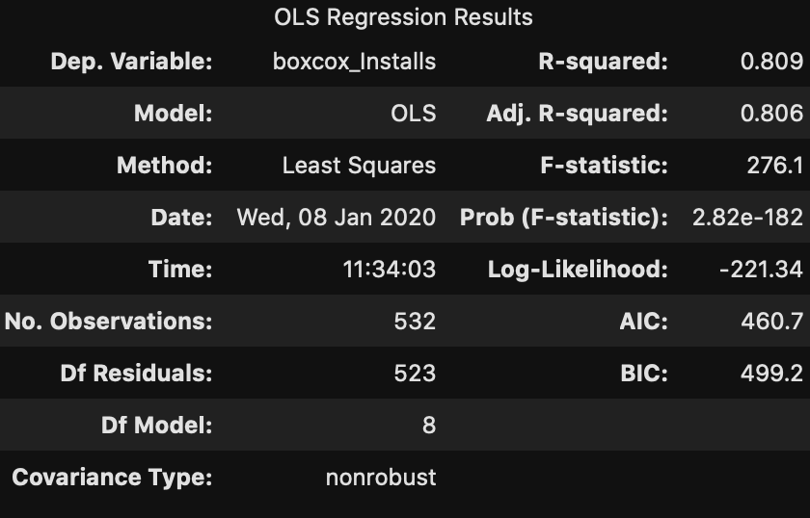
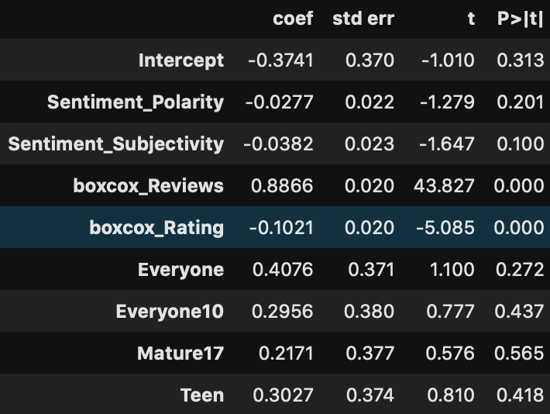
Ordinary Least Squares (OLS) Modeling on Train Sets
Root Mean Squared Error
Train: .367
Test: .379
R-squared for Test Set
0.793

Slide 11
Conclusion
80.9% (R-squared value) of App’s installs on the Play Store can be explained by the features listed previously.
But…

